Slide 1


Thar Institute OF Engineering Science and Technology
NED University of Engineering and Technology
MT-331 PROBABILITY & STATISTICS
Mr. Pirbhu Lal
Lecturer (Visiting Faculty)
MS- Applied Mathematics

Slide 2

Variance
Standard deviation (S.D)
Coefficient of Variation (C.V)

Slide 3

Variance
Standard deviation (S.D)
Coefficient of Variation (C.V)

Slide 4

Variance
Standard deviation (S.D)
Coefficient of Variation (C.V)

Slide 5

Variance
Standard deviation (S.D)
Coefficient of Variation (C.V)
Ex # Calculate the variance, S.D and C.V from the following marks obtained by 9 students.

Slide 6
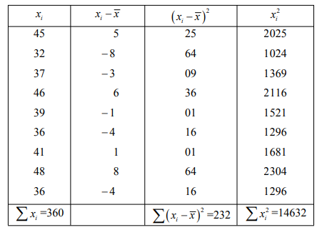
Variance
Standard deviation (S.D)
Coefficient of Variation (C.V)
Ex # Calculate the variance, S.D and C.V from the following marks obtained by 9 students.

Slide 7
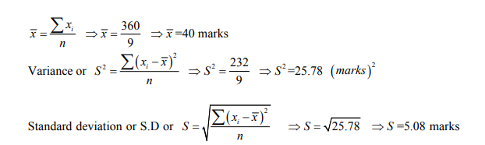

Slide 8
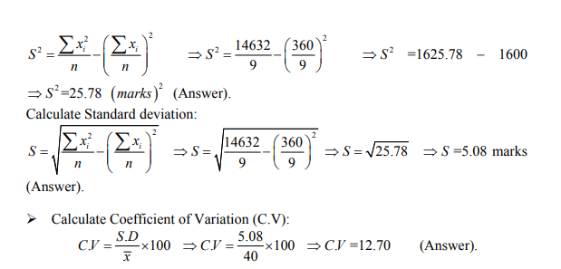
Using the alternative method

Slide 9
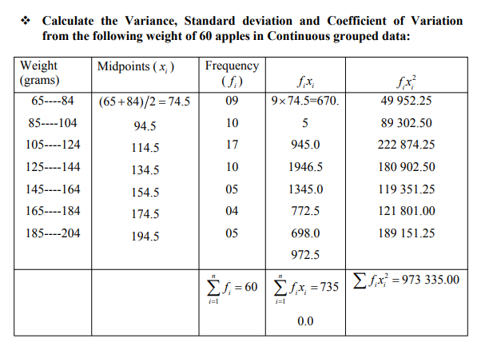

Slide 10
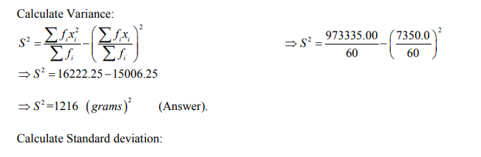
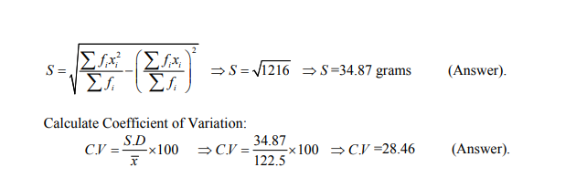

Slide 11
Quartile
Quartiles: “when the observation are arranged in increasing order then the values, that divide the whole data into four (4) equal parts, are called quartiles”
These values are denoted by Q1, Q2 and Q3. It is to be noted that 25% of the data falls below Q1, 50% of the data falls below Q2 and 75% of the data falls bellow Q3.

Slide 12
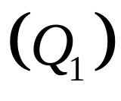
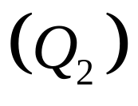
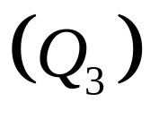

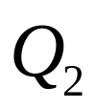
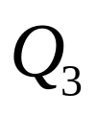
Quartile
Split Ordered Data into 4 Quarters
= first quartile
= second quartile= Median
= third quartile
25%
25%
25%
25%

Slide 13
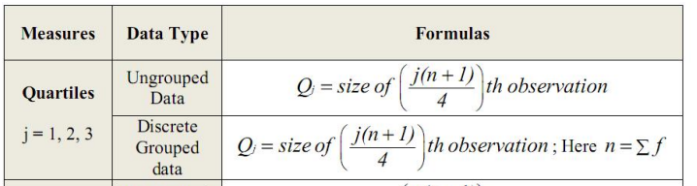
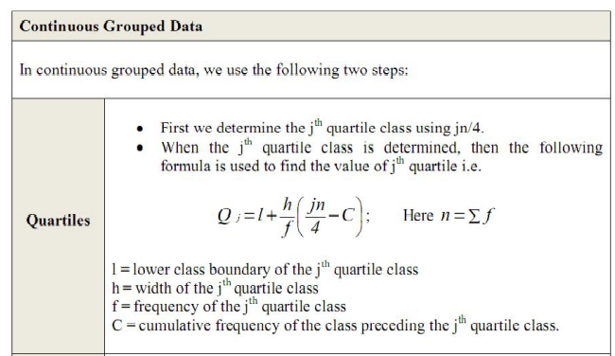

Slide 14
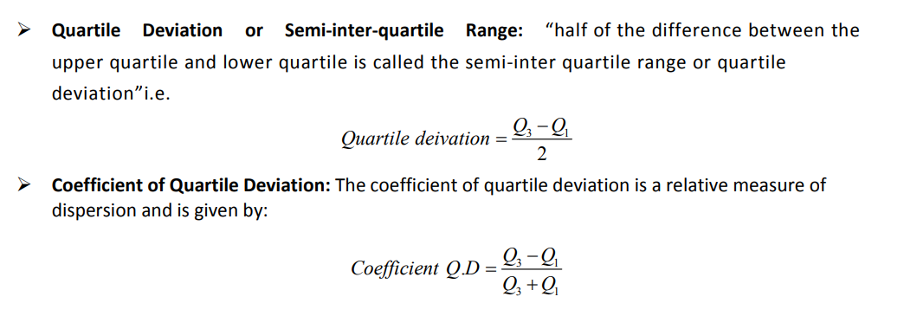

Slide 15
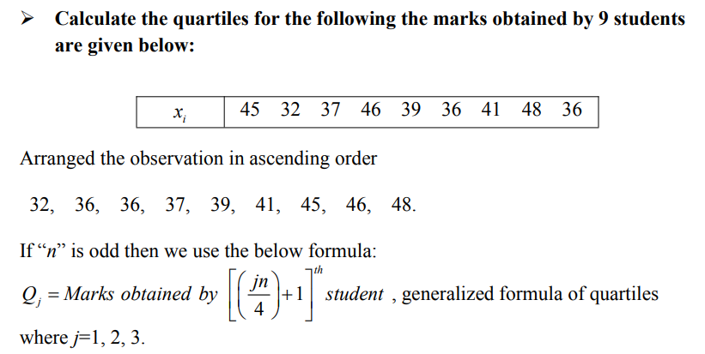
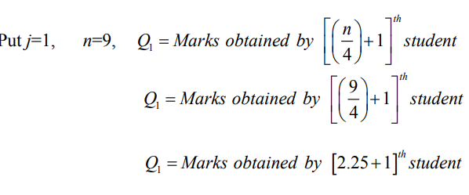
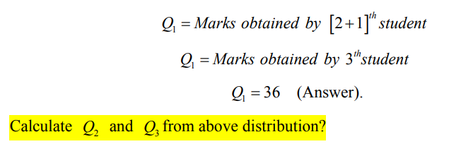

Slide 16
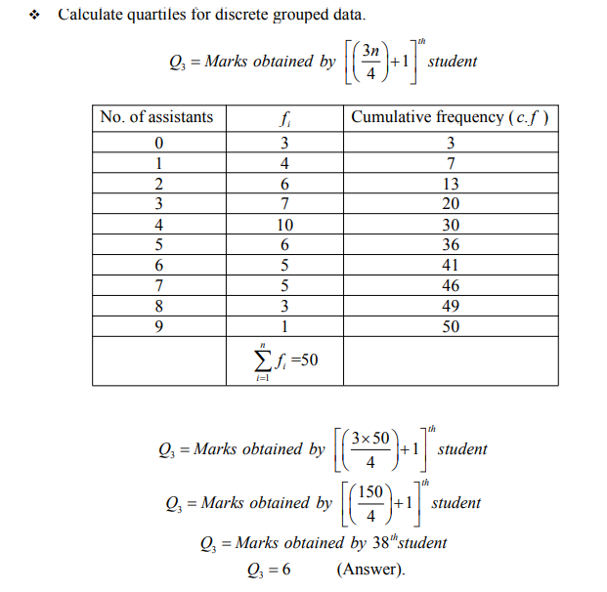

Slide 17
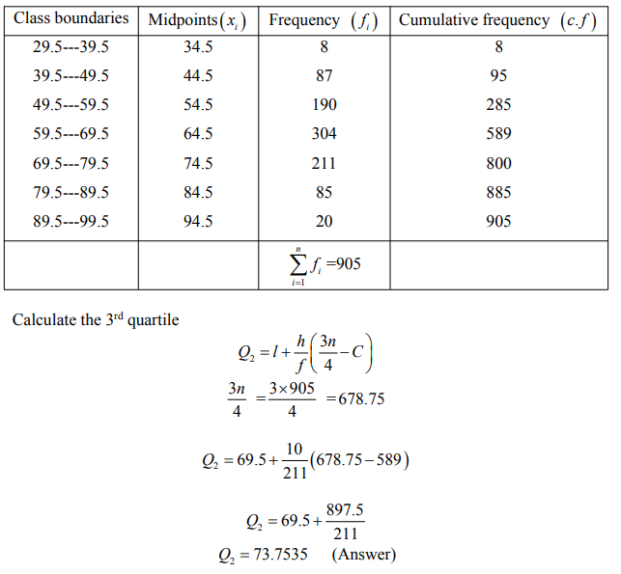

Slide 18


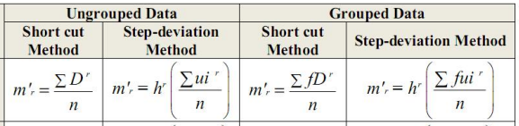
MOMENTS

Slide 19
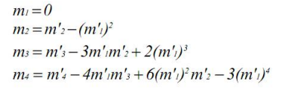

Slide 20
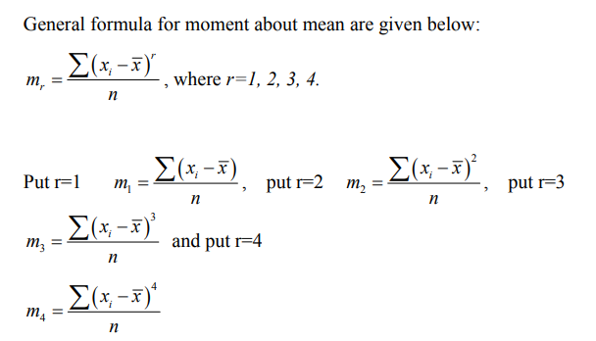

Slide 21
x_{i} 45 32 37 46 39 36 36 41 48

Slide 22
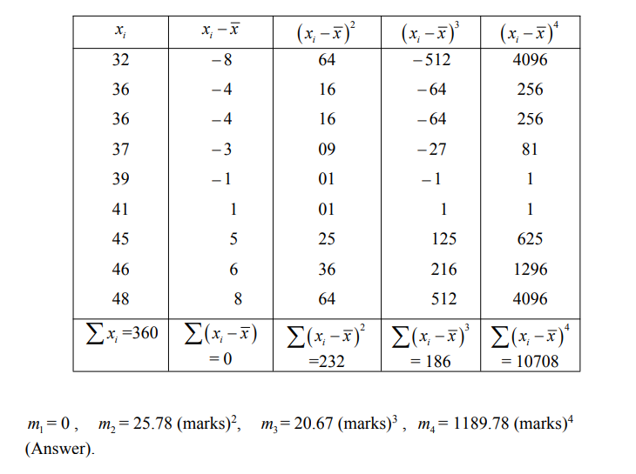

Slide 23
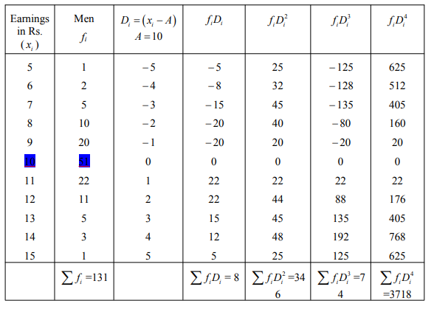

Slide 24
Solution:

Slide 25
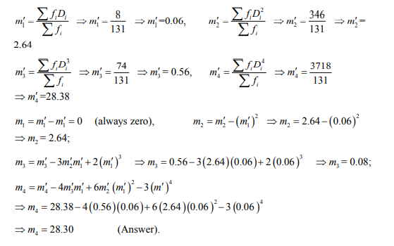

Slide 26
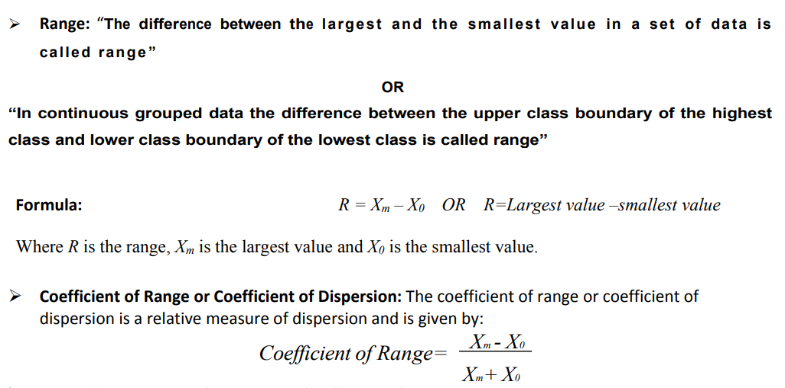
RANGE

Slide 27
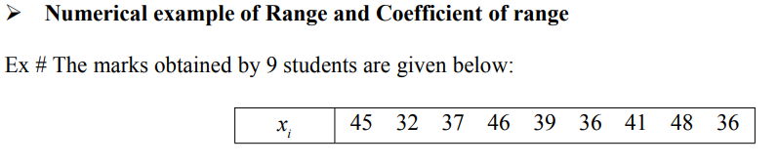
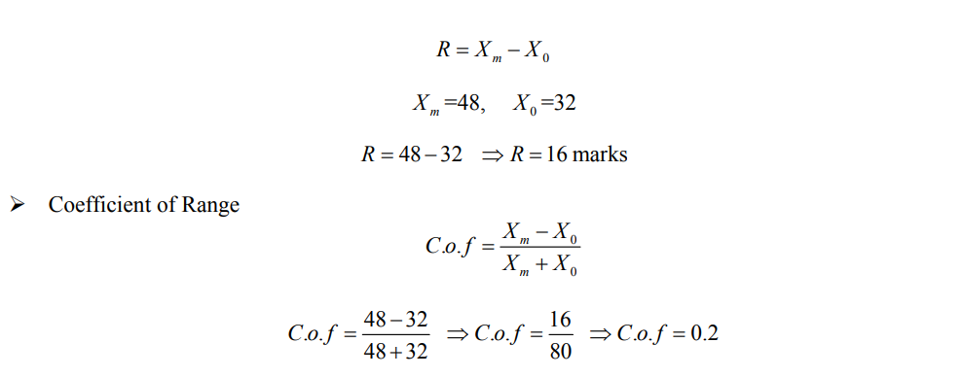
Solution

Slide 28
CORRELATION
Whenever two variables x and y are so related that an increase in the one is accompanied by an increase or decrease in the other, then the variables are said to be correlated.

Slide 29
CORRELATION
Whenever two variables x and y are so related that an increase in the one is accompanied by an increase or decrease in the other, then the variables are said to be correlated.
For example,
The yield of crop varies with the amount of rainfall.

Slide 30
CORRELATION
Whenever two variables x and y are so related that an increase in the one is accompanied by an increase or decrease in the other, then the variables are said to be correlated.
For example,
The yield of crop varies with the amount of rainfall.
If an increase in one variable corresponds to an increase in the other, the correlation is said to be positive.

Slide 31
CORRELATION
Whenever two variables x and y are so related that an increase in the one is accompanied by an increase or decrease in the other, then the variables are said to be correlated.
For example,
The yield of crop varies with the amount of rainfall.
If an increase in one variable corresponds to an increase in the other, the correlation is said to be positive.
If increase in one corresponds to the decrease in the other the correlation is said to be negative.

Slide 32
CORRELATION
Whenever two variables x and y are so related that an increase in the one is accompanied by an increase or decrease in the other, then the variables are said to be correlated.
For example,
The yield of crop varies with the amount of rainfall.
If an increase in one variable corresponds to an increase in the other, the correlation is said to be positive.
If increase in one corresponds to the decrease in the other the correlation is said to be negative.
If there is no relationship between the two variables, they are said to be independent.

Slide 33
CORRELATION
Whenever two variables x and y are so related that an increase in the one is accompanied by an increase or decrease in the other, then the variables are said to be correlated.
For example,
The yield of crop varies with the amount of rainfall.
If an increase in one variable corresponds to an increase in the other, the correlation is said to be positive.
If increase in one corresponds to the decrease in the other the correlation is said to be negative.
If there is no relationship between the two variables, they are said to be independent.
Perfect Correlation: If two variables vary in such a way that their ratio is always constant, then the correlation is said to be perfect

Slide 34
CORRELATION
Correlation is a statistical method used to determine whether a linear relationship between variables exists. Regression is a statistical method used to describe the nature of the relationship between variables, that is, positive or negative, linear or nonlinear.
statisticians use a numerical measure to determine whether two or more variables are linearly related and to determine the strength of the relationship between or among the variables. This measure is called a correlation coefficient. For example, there are many variables that contribute to heart disease, among them lack of exercise, smoking, heredity, age, stress, and diet. Of these variables, some are more important than others; therefore, a physician who wants to help a patient must know which factors are most important.

Slide 35
Scatter Plots
or
Dot Diagram
A scatter plot is a graph of the ordered pairs (x, y) of numbers consisting of the independent variable x and the dependent variable y.

Slide 36
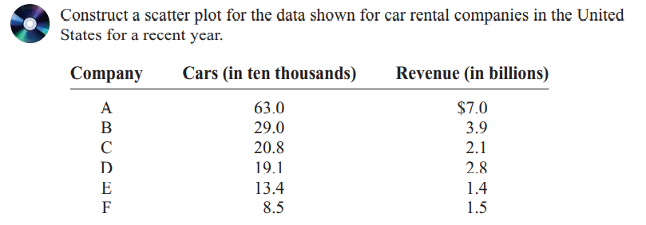
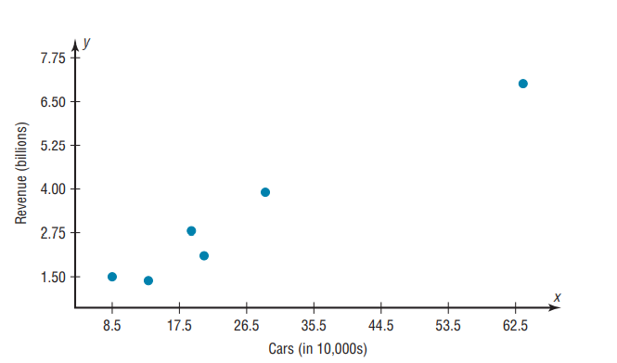

Slide 37
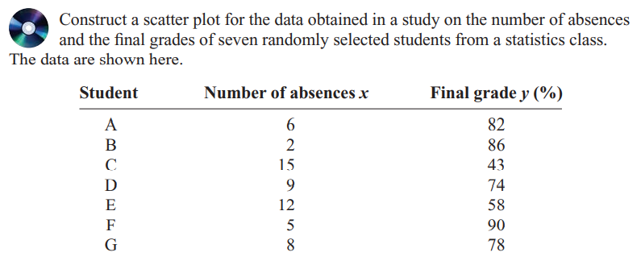
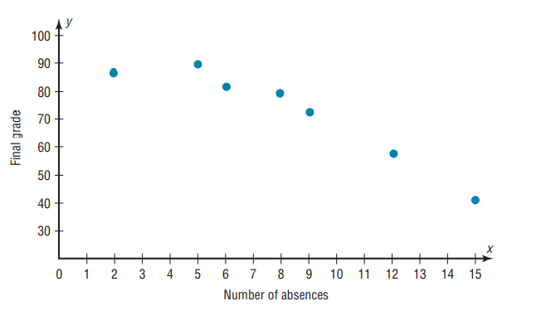

Slide 38
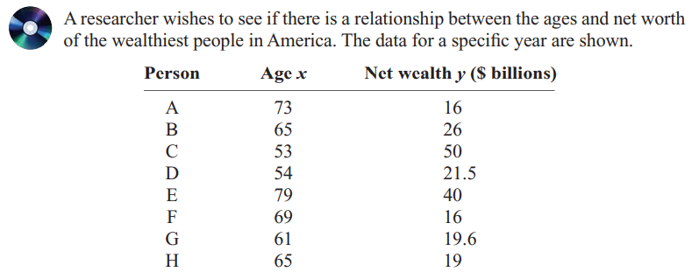
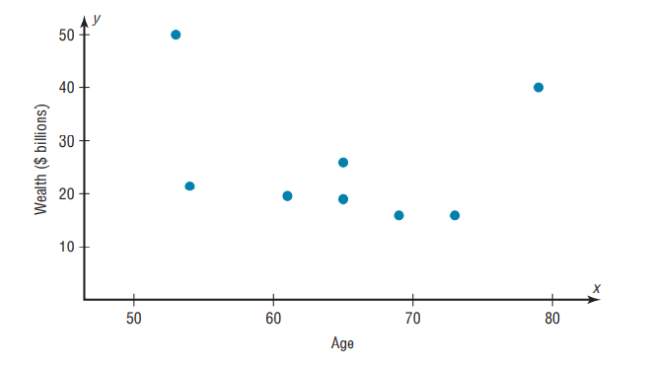

Slide 39
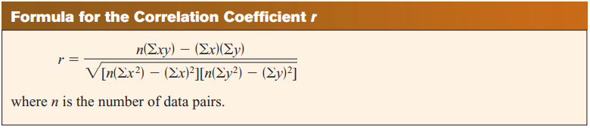
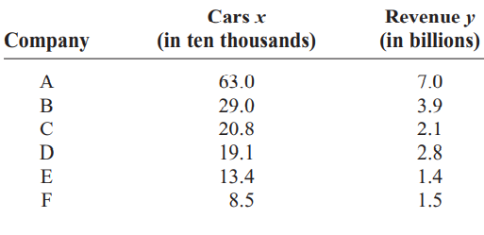
Example:

Slide 40
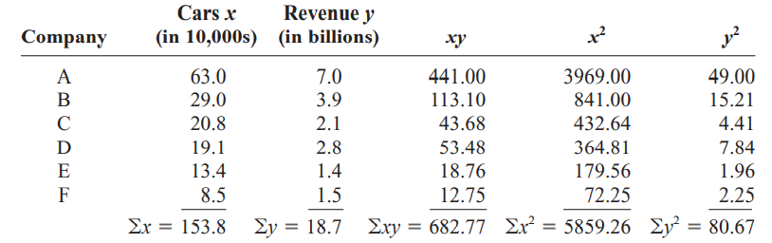
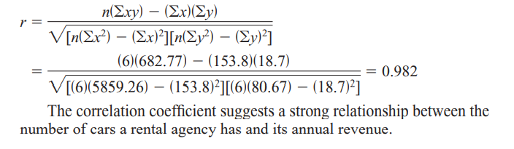

Slide 41
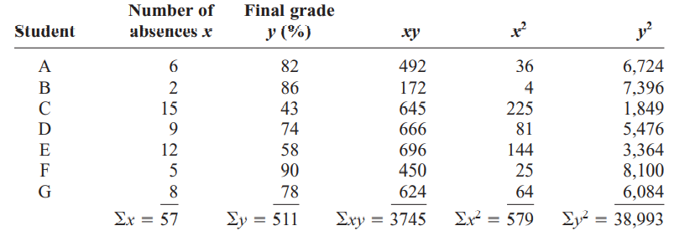
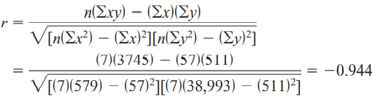

Example:

Slide 42
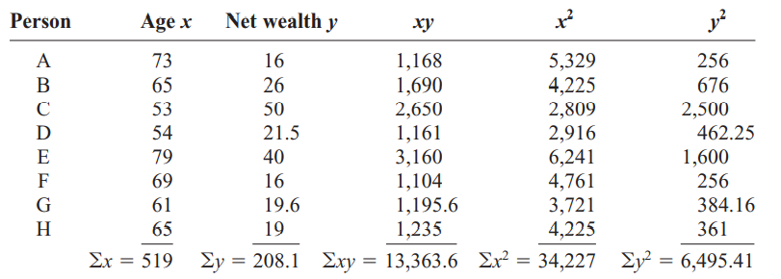
Example:

Slide 43
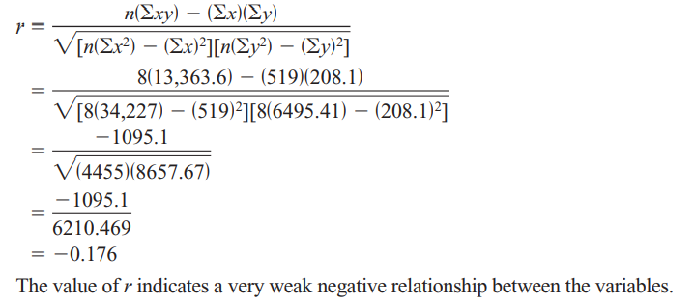
Example:

Slide 44
Regression
relationships between two variables, collect the data and then construct a scatter plot. The purpose of the scatter plot, as indicated previously, is to determine the nature of the relationship.
If the scatter diagram indicates some relationship between two variables x and y, then the dots of the scatter diagram will be concentrated round a curve. This curve is called the curve of regression. Regression analysis is the method used for estimating the unknown values of one variable corresponding to the known value of another variable.
LINE OF REGRESSION
When the curve is a straight line, it is called a line of regression. A line of regression is the straight line which gives the best fit in the least square sense to the given frequency.

Slide 45
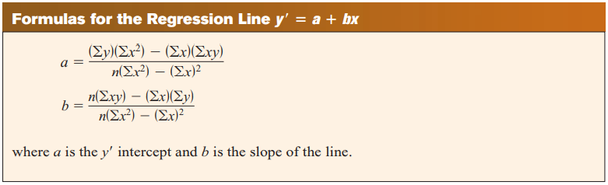
Example:

Slide 46
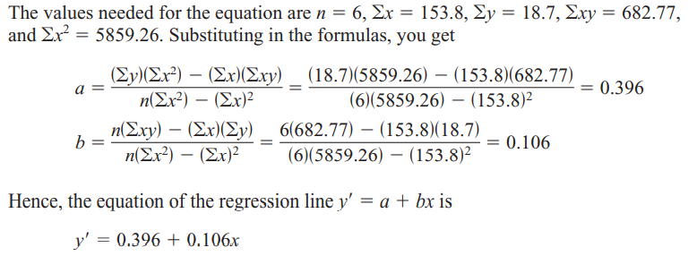

Slide 48
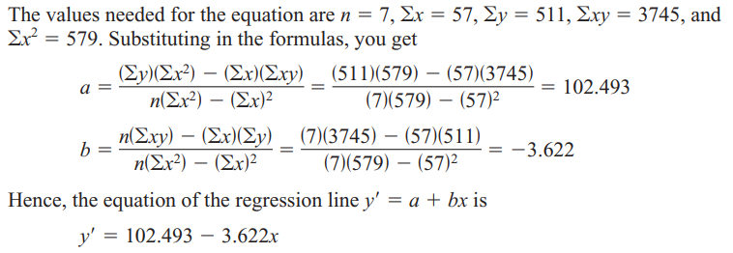
Example:

Slide 49
